Slide 1
Cornwall Central School District
2025 – 2026 Proposed Budget
March 24, 2025
"Striving for Excellence Every Day”
Cornwall Central High School Cornwall Central Middle School Cornwall-on-Hudson Elementary School Cornwall Elementary School Willow Avenue Elementary School

Slide 2
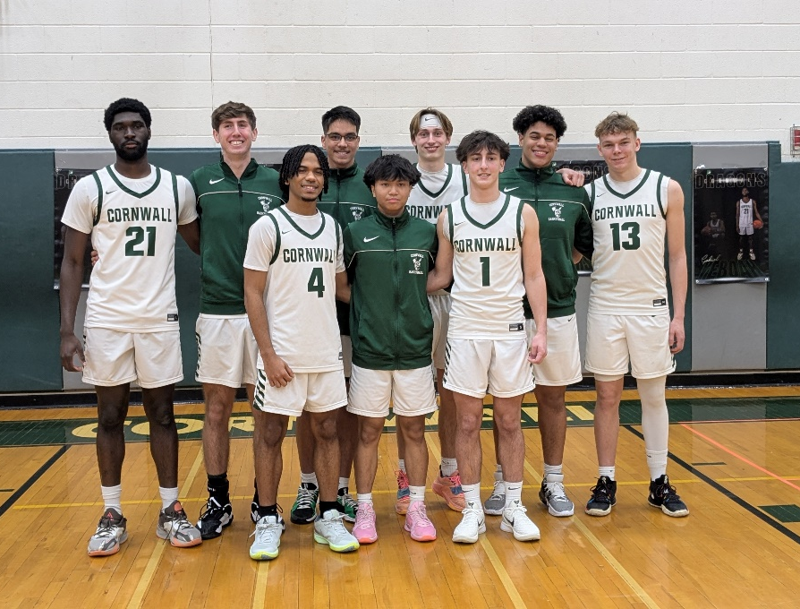
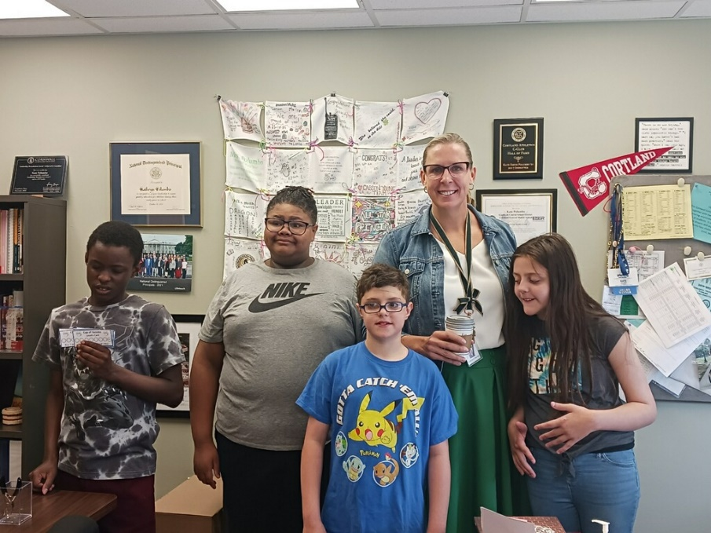
Vision
We envision a school district in which every staff member is a source of knowledge and inspiration, every building is a place of safety and support, every leader is a pillar of integrity, and every student is a source of pride.
Cornwall Central High School Cornwall Central Middle School Cornwall-on-Hudson Elementary School Cornwall Elementary School Willow Avenue Elementary School

Slide 3
Agenda
2025-26 Recommended Expenditures
Recommended Expenditures Summary
Recommended Budget – The How?
2025-26 Recommended Revenue
2025-26 Recommended Budget Summary
2025-26 Recommended Budget Recap
2025-26 Budget Goals Recap
NYS Aid Projections
Needs Assessment – Current
Tax Levy & Approval Rating History Data
Tax Levy Impact
Contingency Budget
New Capital Reserve Proposition
Budget Calendar, Questions & Discussion
Cornwall Central High School Cornwall Central Middle School Cornwall-on-Hudson Elementary School Cornwall Elementary School Willow Avenue Elementary School

Slide 4
2025-26 Recommended Expenditures (Budget)
2025-26 Recommended Budget | 2024-25 Approved Budget | Budget-to-Budget Increase
$ 92,721,136 | $ 90,260,773 | $ 2,460,363
Open Items:
Special education annual reviews
Out-of-district placements
Required related services (e.g., OT, PT, Speech, Counseling, 1:1 Aides)
Graduating students
Pre-school students moving up into District
Contract Negotiations
Teachers, Administrators and Clerical Units
Cornwall Central High School Cornwall Central Middle School Cornwall-on-Hudson Elementary School Cornwall Elementary School Willow Avenue Elementary School

Slide 5
2025-26 Budget – Recommended Expenditures Summary
Budget Expenditure | 2025-26 Budget (Recommended) | 2024-25 Budget (Approved) | Increase / (Decrease)
Salaries | $ 43,654,068 | $ 42,366,645 | $ 1,287,423
Pensions (TRS, ERS, SS) | $ 7,953,380 | $ 8,044,513 | $ (91,133)
Health Insurance | $ 11,951,987 | $ 11,814,917 | $ 139,770
Contractual/Supplies/Equip | $ 10,455,230 | $ 10,006,133 | $ 449,097
Out-of-District Tuition | $ 4,549,338 | $ 4,249,416 | $ 299,922
Debt Service (P&I) | $ 4,211,542 | $ 3,809,259 | $ 402,283
Transportation | $ 6,141,848 | $ 6,016,565 | $ 125,283
Utilities | $ 1,274,389 | $ 1,161,661 | $ 112,728
Occupational Education | $ 1,591,560 | $ 1,551,120 | $ 40,440
Insurance | $ 637,794 | $ 612,244 | $ 25,550
Transfer to Capital Fund | $ 300,000 | $ 631,000 | $ (331,000)
TOTAL | $ 92,721,136 | $ 90,260,773 | $ 2,460,363
Cornwall Central High School Cornwall Central Middle School Cornwall-on-Hudson Elementary School Cornwall Elementary School Willow Avenue Elementary School

Slide 6
2025-26 Recommended Budget – The How?
Teacher Attrition:
Teachers leaving the profession – retiring.
As of June 30, 2025
10 total teacher retirements.
5 teachers positions will be filled through traditional posting and hiring process.
5 teachers positions can be filled based on redistribution of staff due to enrollment or program shifts.
No teachers or staff will be but cut or excessed.
Instructional programs will continue to develop.
Cornwall Central High School Cornwall Central Middle School Cornwall-on-Hudson Elementary School Cornwall Elementary School Willow Avenue Elementary School

Slide 7
2025-26 Recommended Revenue Projections
2025-26 Recommended Revenue Projections | 2024-25 Projected Revenue | Budget-to-Budget Increase
$ 90,364,365 | $ 87,435,879 | $ 2,928,486
Assumptions:
Maximum allowable property tax levy increase = 3.08% = $1,615,813
2.50% property tax levy increase used in revenue projection = $1,311,537
Increase in State Aid = $1,020,442
Increase in miscellaneous revenue = $232,131
Open Items:
Final State Aid Figures
Cornwall Central High School Cornwall Central Middle School Cornwall-on-Hudson Elementary School Cornwall Elementary School Willow Avenue Elementary School

Slide 8
2025-26 Recommended Budget Summary
 | Amount
Recommended Budget (expenditures) | $ 92,721,136
Recommended Revenues:
Property Tax Levy (2.50% increase) | 53,773,900
State Aid | 34,997,138
Miscellaneous | 1,593,327
Total Recommended Revenues | 90,364,365
Current Shortfall – without Assigned Fund Balance | $ (2,356,771)
Recommended Assigned Fund Balance | 2,356,771
Current Deficit for Instructional and Operational Needs – with Assigned Fund Balance | $ 0
Cornwall Central High School Cornwall Central Middle School Cornwall-on-Hudson Elementary School Cornwall Elementary School Willow Avenue Elementary School

Slide 9
2025-26 Recommended Budget – Recap
2025-26 Revised Budget
$ 92,721,136
2025-26 Revised Revenue Projections
$ 90,364,365
Current Shortfall – without Assigned Fund Balance
$ (2,356,711)
Current Shortfall – with Assigned Fund Balance of $2,356,711
$ 0
Assumptions:
Maximum allowable property tax levy increase = 3.08% = $1,615,813
2.50% property tax levy increase used in revenue projection = $1,311,537
Increase in State Aid = $1,020,442
Increase in miscellaneous revenue = $232,131
Open Items:
Special education annual reviews
Out-of-district placements
Required related services (e.g., OT, PT, Speech, Counseling, 1:1 Aides)
Graduating students
Pre-school students moving up into District
Contract Negotiations
Teachers, Administrators and Clerical Units
Final State Aid Figures
Cornwall Central High School Cornwall Central Middle School Cornwall-on-Hudson Elementary School Cornwall Elementary School Willow Avenue Elementary School

Slide 10
2025-26 Budget Goals Recap
2025-26 Budget Goals:
Lowest possible tax levy increase, but above all -- stay within the Property Tax Cap.
2.5% Property Tax Levy.
Maintain current programs.
No programs or staff were eliminated.
Continue to support and grow instructional and operational programs.
Instructional and operational programs will continue to develop.
2025-26 Additional Budget Accomplishments:
Reduce reliance on appropriated fund balance:(More info to come.)
2025-26 = $2,356,711
2024-25 = $2,824,894
2023-24 = $2,500,000
Cornwall Central High School Cornwall Central Middle School Cornwall-on-Hudson Elementary School Cornwall Elementary School Willow Avenue Elementary School

Slide 11
2025-26 Budget – NYS Aid Projections
The NYS budget is expected to be voted on and approved the week of April 1, 2025.
The NYS budget will present the CCSD with some options:
Scenario #1:
The District receives more state aid than currently projected?
Reduce the 2.50% tax levy increase.
Reduce the amount of assigned fund balance.
A combination of the two options above.
Do nothing – the additional state aid will create / add to next year’s surplus.
Expand recommended expenditures (programs, staffing, capital) to match additional revenue.
Scenario #2:
The District receives less state aid than currently projected?
Increase the tax levy beyond the 2.50% increase.
Increase the amount of assigned fund balance.
A combination of the two options above.
Cornwall Central High School Cornwall Central Middle School Cornwall-on-Hudson Elementary School Cornwall Elementary School Willow Avenue Elementary School

Slide 12
Needs Assessment – Present – District
Cornwall Central Schools – District
Budget Request | Cost $
1.0 Guidance Counselor (COH/WAES) | $133,252
1.0 Early Intervention Support Teacher (COH/WAES) | $133,252
1.0 Early Intervention Support Teacher (CES) | $133,252
1.0 Instructional Coach (COH/CES/WAES) | $133,252
Guidance Department Chairperson (CCMS) | $4,496
1.0 ELL Teacher (CCHS) | $133,252
1.0 CPSE Chairperson (PPS) | $133,252
1.0 Custodian (B&G: CCHS at Pool) | $73,394
4.0 Safety Monitors (COH/CES/WAES/CCMS) | $257,480
Universal Pre-K Program - Additional 20 Seats | $71,340
Increase Uncertified Substitute Teacher Compensation | $7,292
TOTAL | $1,213,514
Total Cost of Needs Assessment = $1,213,514
Cornwall Central High School Cornwall Central Middle School Cornwall-on-Hudson Elementary School Cornwall Elementary School Willow Avenue Elementary School

Slide 13
Tax Levy & Approval Rating History Data
Tax Levy & Approval Rating History Data
Year | Adopted Tax Levy Increase | Maximum Allowable Tax Levy | Approval Ratings
2024-25 | 1.72% | 3.12% | 74%
2023-24 | 1.20% | 1.76% | 73%
2022-23 | 0.00% | 4.87% | 79%
2021-22 | 1.79% | 2.74% | 57%
2020-21 | 1.38% | 2.56% | 60%
2019-20 | 2.24% | 2.24% | 55%
2018-19 | 3.16% | 3.21% | 53%
2017-18 | 1.74% | 1.74% | 73%
2016-17 | 1.50% | 1.50% | 71%
2015-16 | 1.88% | 2.43% | 69%
10-year Average | 1.66% | 2.62% | 66%
Cornwall Central High School Cornwall Central Middle School Cornwall-on-Hudson Elementary School Cornwall Elementary School Willow Avenue Elementary School

Slide 14
Tax Levy Impact
Residence - Fair Market Value | Estimated Tax Increase
 | Tax/Year | Tax/Month
$250,000 | $206 | $17
$350,000 | $288 | $24
$450,000 | $371 | $31
Assumptions:
1. Increase in Tax Levy of 2.5%
2. Appropriated fund balance of $2,356,711
3. STAR Exemption included
4. No change in Town Assessed Value
5. No change in equalization rates
School Tax Levy
While the Maximum Allowable Tax Levy is 3.08%, the 25-26 Recommended Budget reflects a 2.50% increase. Note: for every 1% increase, the tax levy increases by $524,623.
The above reflects the estimated increase in school taxes under the Proposed Tax Levy increase of 2.50%. Note: based on current 2024-25 assessment levels and equalization rates.
Cornwall Central High School Cornwall Central Middle School Cornwall-on-Hudson Elementary School Cornwall Elementary School Willow Avenue Elementary School

Slide 15
Contingency Budget
Budget Passed or Defeated?
If proposed budget passes, enact budget effective July 1st.
If proposed budget is defeated, district may do one of the following:
Resubmit the defeated budget allowing enough time for legal notices
Submit a revised budget allowing enough time for legal notices
Adopt a contingent budget
If the resubmitted or revised budget is defeated, the BOE must adopt a contingent budget.
Uniform Statewide Budget Revote Date - 3rd Tuesday in June
Structure of Contingent Budget
Includes teachers’ salaries and ordinary contingent expenses.
Teachers salaries include professional educator positions certified by the State Education Department including teachers, teacher assistants, administrators, and various professional specialists working within pupil personnel services.
Ordinary contingent expenses are those necessary to provide the minimum services legally required to:
Operate and maintain school buildings and the educational program
Preserve the property of the district; and
Ensure the health and safety of students and staff
The Board of Education determines which appropriations constitute ordinary contingent expenses.
Cornwall Central High School Cornwall Central Middle School Cornwall-on-Hudson Elementary School Cornwall Elementary School Willow Avenue Elementary School

Slide 16
Contingency Budget
What is a contingency budget and why would we need one?
If the budget vote fails twice, the District must adopt a contingency budget which has many requirements including:
All programs face potential impacts
No increase to the prior year’s tax levy - Tax levy at 0%
No purchases of buses or equipment
Capital Outlay project is eliminated (effect on tax cap calculation going forward)
Administrative Component of Budget is limited to prior year’s % of total budget
To the extent aid is specifically designated for the purchase of equipment (computer hardware), such equipment can be considered an ordinary contingent expense.
No use of school facilities by outside groups (unless costs are reimbursed)
Taylor law must apply to consider ordinary contingent expense
Certain field trips are eliminated (unless fully reimbursed)
Cornwall Central High School Cornwall Central Middle School Cornwall-on-Hudson Elementary School Cornwall Elementary School Willow Avenue Elementary School

Slide 17
New Capital Reserve Proposition
On the May 20, 2025 ballot:
RESOLVED, that the Cornwall Central School District, is hereby authorized to establish a new capital reserve fund pursuant to Section 3651 of the Education Law to be designated 2025 Buildings and Facilities Capital Reserve Fund for the construction of additions to, improvements to, reconstruction and equipping of School District buildings, facilities and athletic fields and tracks, including original furnishings, equipment, machinery, apparatus, appurtenances, and site and incidental improvements and expenses in connection therewith, at an ultimate amount of $5,000,000, plus accrued interest and investment earnings, with a probable term of ten (10) years, the source of funding to be surplus dollars and/or legally available funds available to the District when it closes its books every June 30.
Cornwall Central High School Cornwall Central Middle School Cornwall-on-Hudson Elementary School Cornwall Elementary School Willow Avenue Elementary School

Slide 18
2025-26 Budget Calendar, Questions & Discussion
February 10, 2025 BOE Budget Session (7 pm – Cornwall Elementary)
(Monday)
February 24, 2025 BOE Budget Session (7 pm – Cornwall Elementary)
(Monday)
March 10, 2025 BOE Budget Session (7 pm – Cornwall Elementary)
(Monday)
March 24, 2025 BOE Budget Session (7 pm – Cornwall Elementary)
(Monday)
April 7, 2025 BOE Budget Session (7 pm – Cornwall Elementary)
(Monday)
April 24, 2025 BOE Budget Session (7 pm – Cornwall Elementary)
(Thursday) 2025-26 Budget adoption
May 6, 2025 BOE Work Session (7 pm - Cornwall Elementary)
(Tuesday) Annual Budget Hearing
May 20, 2025 Budget vote and Board of Education Election
(Tuesday) (6 am to 9 pm – Cornwall Middle School Gymnasium)
Cornwall Central High School Cornwall Central Middle School Cornwall-on-Hudson Elementary School Cornwall Elementary School Willow Avenue Elementary School

